Slide 1


Asia Pacific College
Disaster Response
Bueno | Belchez | Malapo | Moreta

Slide 2
Law and Order
UPDATES
Bueno | Belchez | Malapo | Moreta

Slide 3
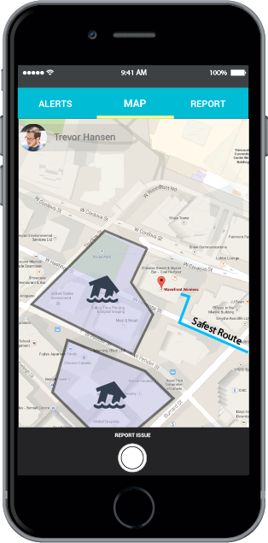
Command and Response APP
A proprietary mobile app which uses wireless mesh networking (Bluetooth or Wifi) to enable smartphones communicate even without network or Internet connection.

Slide 4
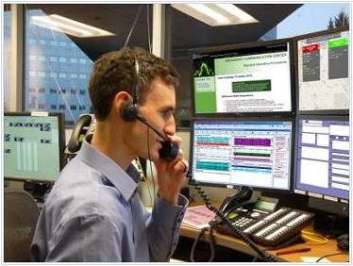
Scope
Identify the level of disaster
Send reports for future response
Communication between the respondent through message, call or video
Maintain peace and order within the area

Slide 5
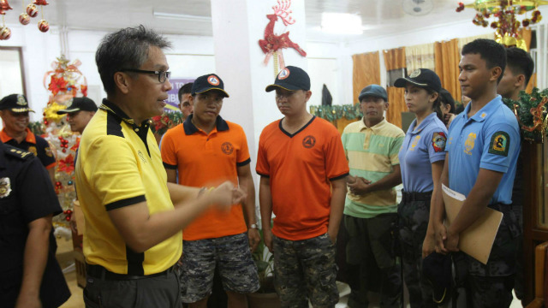
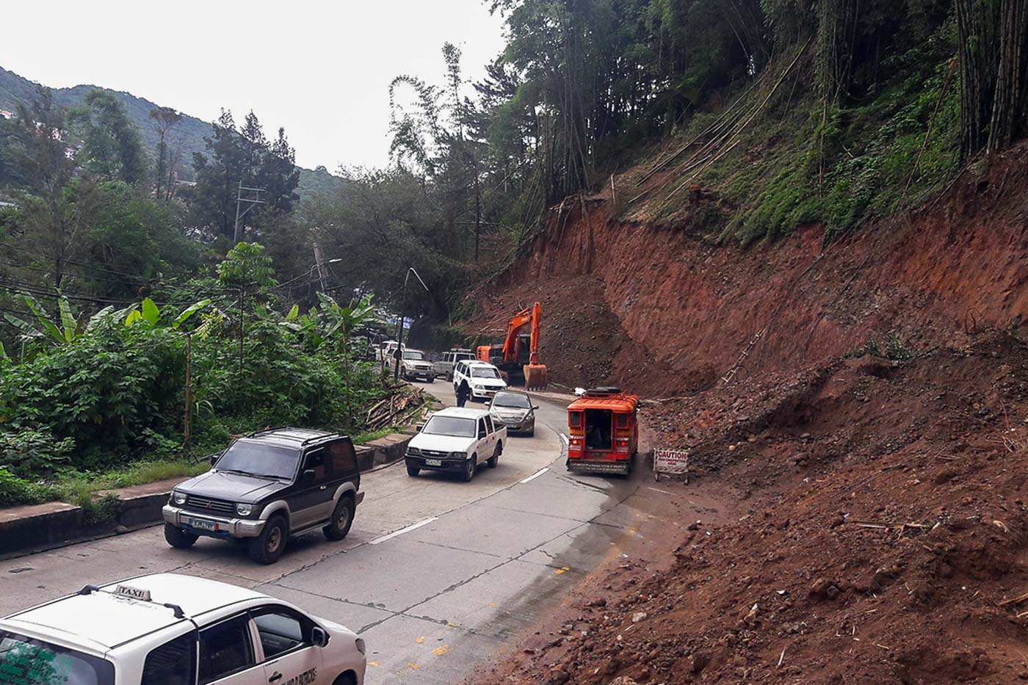
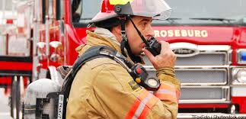
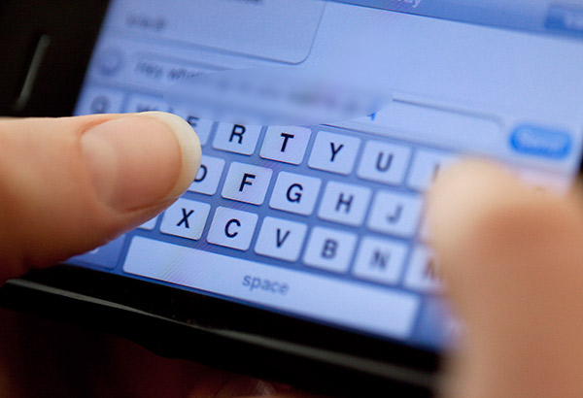
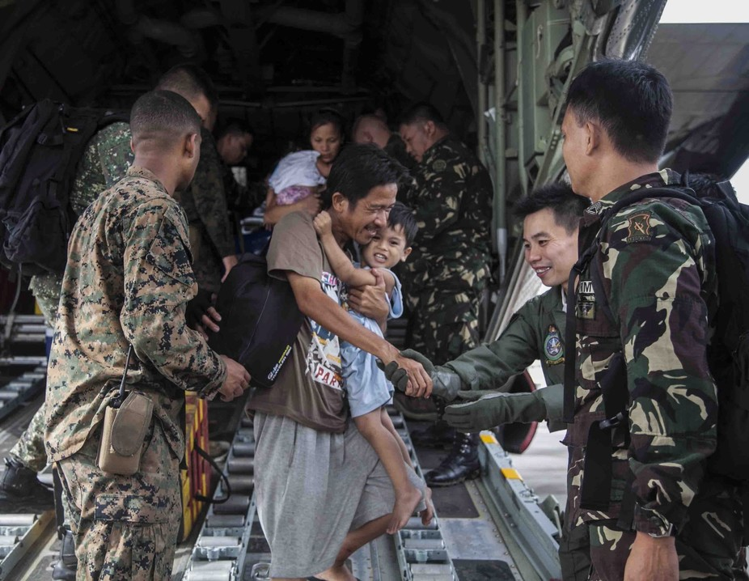
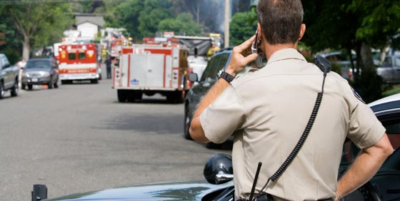
TRANSMIT REPORTS / COMMANDS

Slide 6
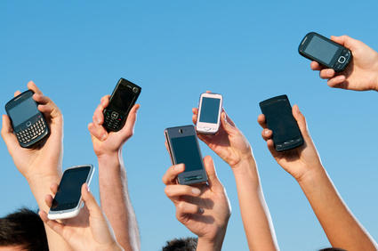
Requirements & Specifications
Mobile Device (API 16 up to latest)
Bluetooth or Wifi Connectivity

Slide 7
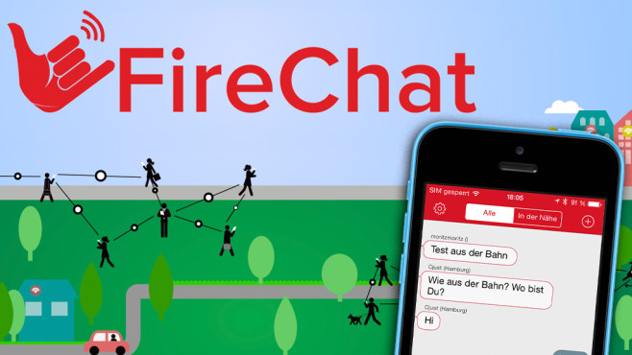
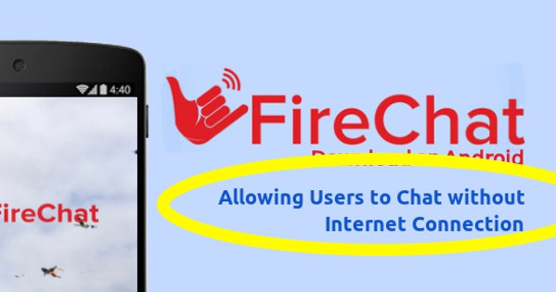
Similar APP

Slide 8
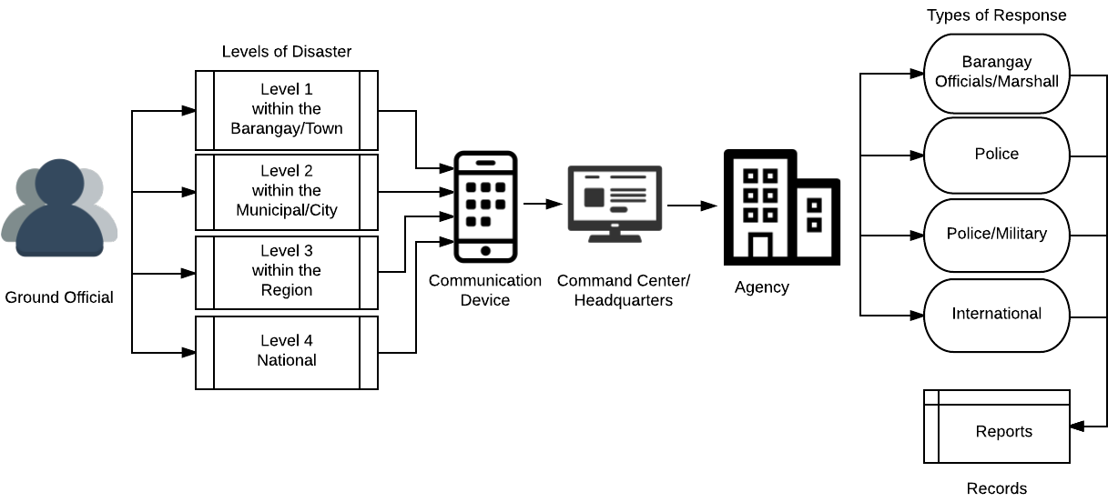
Conceptual Framework Diagram

Slide 9
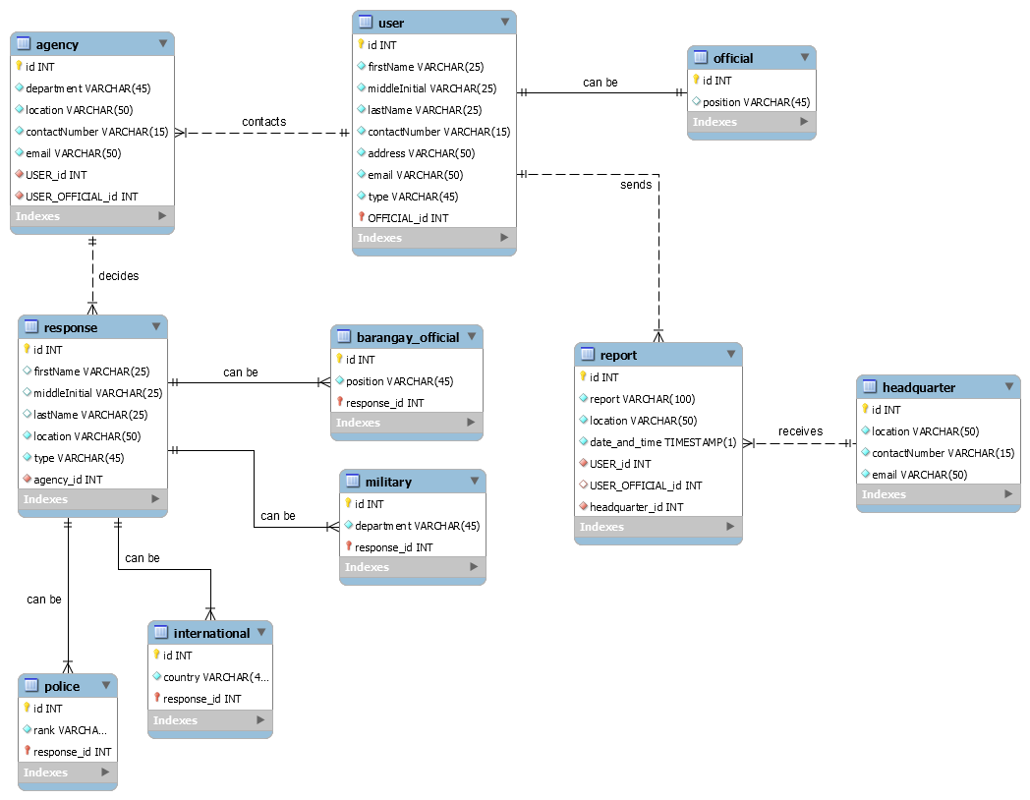
Entity-Relationship Diagram

Slide 10
Context Flow Diagram

Slide 11
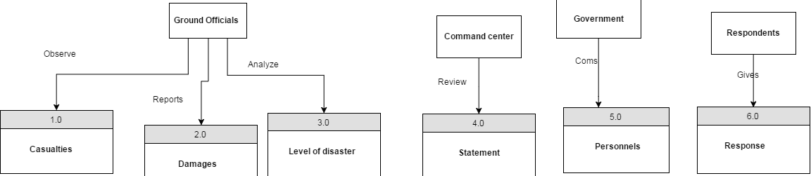
Data Flow Diagram

Slide 12

Law and Order

